Slide 1
到上周为止引物完成情况
非标记引物3235OD
FAM 标记引物440OD

Slide 2

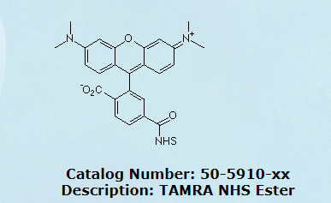
活化酯进度
汤明祥做了30OD的TAMRA引物,等周一拿给葛老师测试。

Slide 3

反应大约用掉0.5mg活化酯,相当于947.8nmol。
DNA转化率超过60%，活化酯转化率约10%。
DNA粗品是用230ulPH=8.3的0.1MNaHCO3溶解, DNA浓度是0.76mM。
TAMRA活化酯用25ulDMSO溶解，浓度是37.9mM，分3次加到DNA溶液中。

Slide 4
待完成引物订单
非标记引物10810OD
FAM 标记引物1580OD
HEX 标记引物1670OD

Slide 5
下周计划
1.进一步提高HPLC纯化的效率。
2.提高合成效率，需要等500nmol柱子到货，3900用100nmol柱子已经不能满足需求。
3.合HEX标记的引物。
4.活化酯尽快做起来。

Slide 6
下面是一些单体的信息。

Slide 7
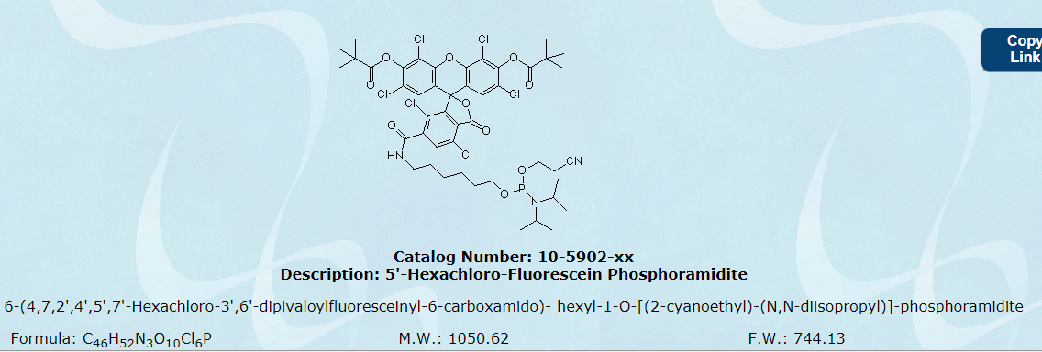
HEX 1g 1瓶（兆维）
Coupling: 3 minute coupling time recommended.
Deprotection: Ammonium Hydroxide for 24 hrs at room temperature or as required by nucleobases.
Storage: Freezer storage, -10 to -30°C, dry
Stability in Solution: 1-2 days, <90% efficient after 4 days

Slide 8
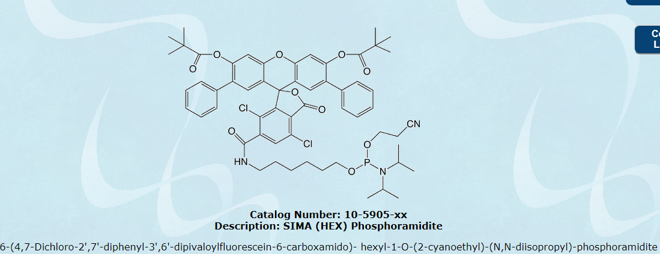
SIMA(HEX) 0.25g 10瓶（GLEN）可能用不到
Coupling: 3 minute coupling time recommended.
Deprotection: No changes needed from standard method recommended by synthesizer manufacturer.
Storage: Freezer storage, -10 to -30°C, dry
Stability in Solution: 1-2 days, <90% efficient after 4 days

Slide 9
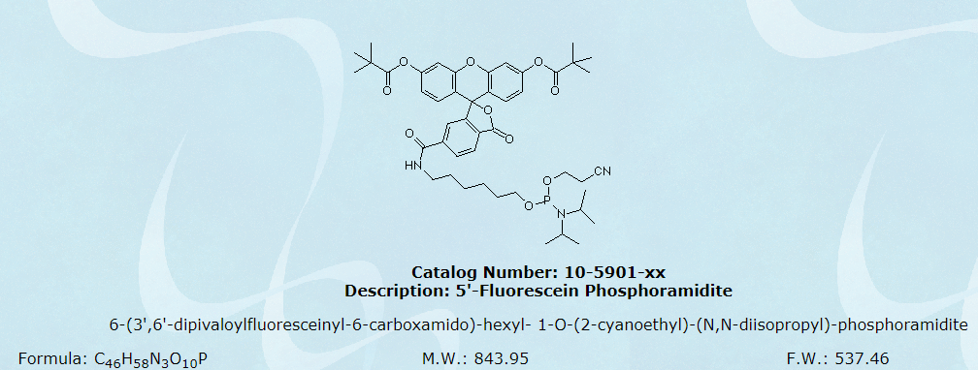
6-FAM 1g 1瓶（兆维）
Coupling: 3 minute coupling time recommended
Deprotection: Use ammonium hydroxide and deprotect as required by nucleobases. When using AMA, a small amount of a non-fluorescent impurity will be formed. To eliminate this impurity, first deprotect with ammonium hydroxide for 30 minutes at room temperature, add an equal volume of 40% methylamine and then complete the deprotection as required by the nucleobases - e.g. 10 minutes at 65°C or 2 hours at room temperature for standard bases.
Storage: Freezer storage, -10 to -30°C, dry
Stability in Solution: 1-2 days, <90% efficient after 4 days

Slide 10
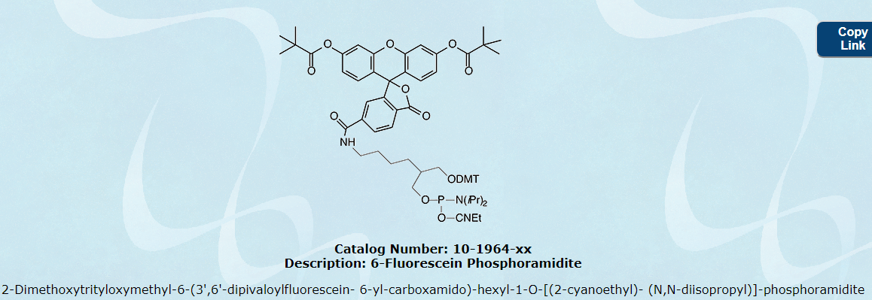
6-Fluorescein Phosphoramidite 0.25g 7瓶（GLEN）跟葛老师用的不一样，暂时不用
Coupling: 15 minute coupling time recommended.
Deprotection: Use ammonium hydroxide and deprotect as required by nucleobases. When using AMA, a small amount of a non-fluorescent impurity will be formed. To eliminate this impurity, first deprotect with ammonium hydroxide for 30 minutes at room temperature, add an equal volume of 40% methylamine and then complete the deprotection as required by the nucleobases - e.g. 10 minutes at 65°C or 2 hours at room temperature for standard bases.
Storage: Refrigerated storage, maximum of 2-8°C, dry
Stability in Solution: 2-3 days

Slide 11
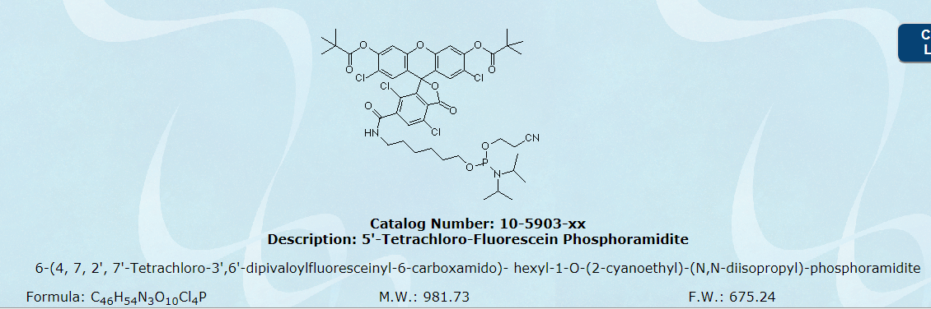
TET 1g 1瓶（兆维）0.25g 1瓶（GLEN）
Coupling: 3 minute coupling time recommended
Deprotection: No changes needed from standard method recommended by synthesizer manufacturer.
Storage: Freezer storage, -10 to -30°C, dry
Stability in Solution: 1-2 days, <90% efficient after 4 days

Slide 12
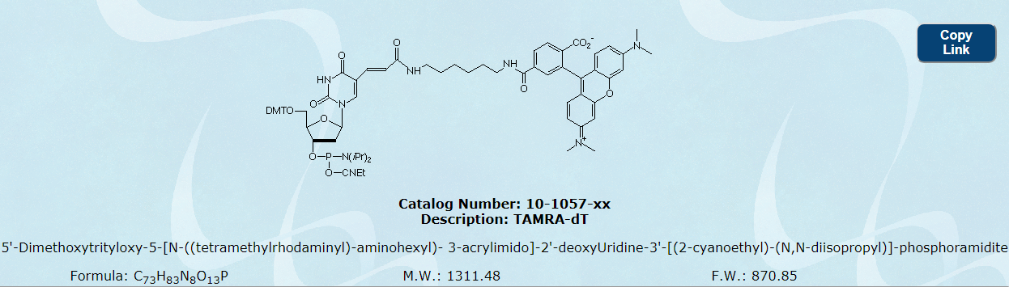
TAMRA-dT 0.25g 10瓶（GLEN）
Diluent: 10% THF in Anhydrous Acetonitrile
Coupling: Dissolve this product in anhydrous acetonitrile:THF (9:1). Allow 15 minutes for the product to go into solution. A 6 minute coupling time is recommended. Use either dmf-dG (10-1029-xx) with standard monomers and Cap A or use UltraMILD monomers (dA: 10-1601-xx, dC: 10-1015-xx, dG: 10-1621-xx, dT: 10-1030-xx ) and UltraMILD Cap Mix A (40-4210-xx/ 40-4212-xx)
Deprotection: If standard monomers were used, deprotect in tert-butylamine/water 1:3 (v/v) for 6 hours at 60 °C. If UltraMILD monomers were used, deprotect in 0.05M Potassium Carbonate in Methanol, 4 hours at Room Temperature. See Technical Bulletin for details (http://www.glenresearch.com/Technical/TB_UltraMild_Deprotection.pdf).
Storage: Freezer storage, -10 to -30°C, dry
Stability in Solution: 24 hours

Slide 13
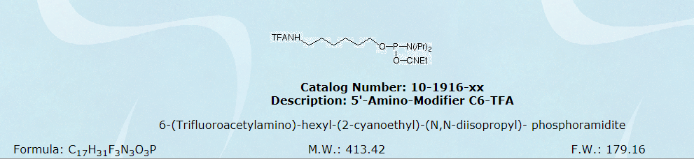
5'-Amino-Modifier C6-TFA 0.25g 7瓶（兆维）0.25g 10瓶（GLEN）
Coupling: No changes needed from standard method recommended by synthesizer manufacturer.
Deprotection: No changes needed from standard method recommended by synthesizer manufacturer.
Storage: Freezer storage, -10 to -30°C, dry
Stability in Solution: 2-3 days

Slide 14
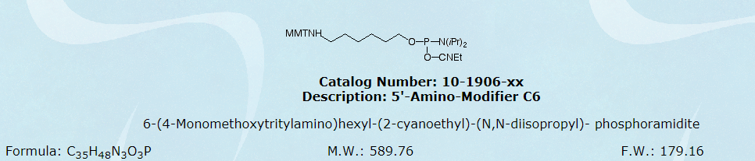
5'-Amino-Modifier C6 0.25g 2瓶（GLEN）
Deprotection: Deprotect as required by nucleobases. WARNING: Drying down the oligo after cleavage and deprotection without addition of an non-volatile base (for example, TRIS) will lead to loss of the Trityl protecting group.
Storage: Freezer storage, -10 to -30°C, dry
Stability in Solution: 2-3 days

Slide 15
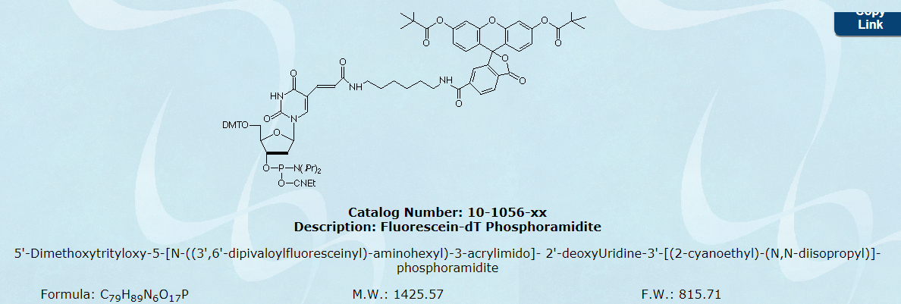
Fluorescein-dT Phosphoramidite 0.25g 5瓶（GLEN）
Coupling: 10 minute coupling time recommended.
Deprotection: Use ammonium hydroxide and deprotect as required by nucleobases. When using AMA, a small amount of a non-fluorescent impurity will be formed. To eliminate this impurity, first deprotect with ammonium hydroxide for 30 minutes at room temperature, add an equal volume of 40% methylamine and then complete the deprotection as required by the nucleobases - e.g. 10 minutes at 65°C or 2 hours at room temperature for standard bases.
Storage: Refrigerated storage, maximum of 2-8°C, dry
Stability in Solution: 24 hours

Slide 16
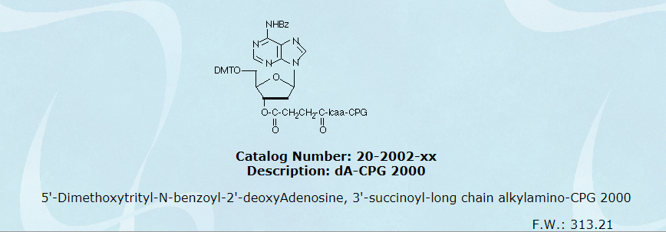
dA-CPG 2000 1g 2瓶(GLEN)
Coupling: No changes needed from standard method recommended by synthesizer manufacturer.
Deprotection: Deprotect using the protocol required by the nucleobases.
Storage: Controlled room temperature or lower, dry
Stability in Solution: Not Applicable

Slide 17
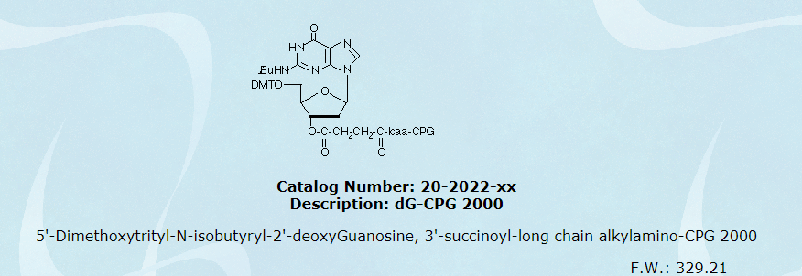
dG-CPG 2000 1g 2瓶(GLEN)

Slide 18
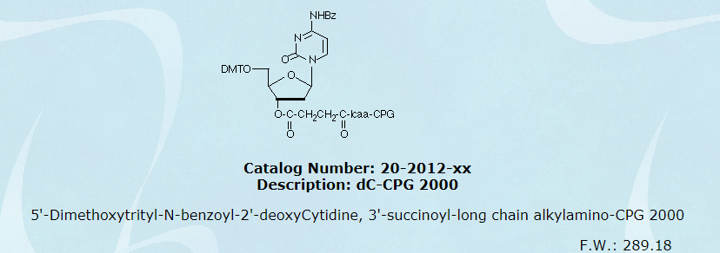
dC-CPG 2000 1g 2瓶(GLEN)

Slide 19
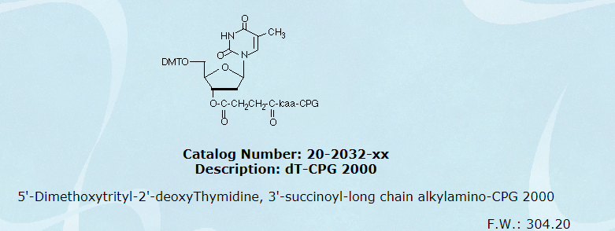
dT-CPG 2000 1g 2瓶(GLEN)

